Slide 1

Playtesting for Indie
Game Studios
Adrian Campbell
Founder, Testify
@PlayTestify

Slide 2
The obvious objective of video games is to entertain people by surprising them with new experiences.
Shigeru Miyamoto

Slide 3
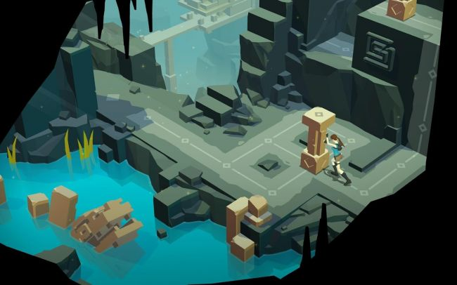
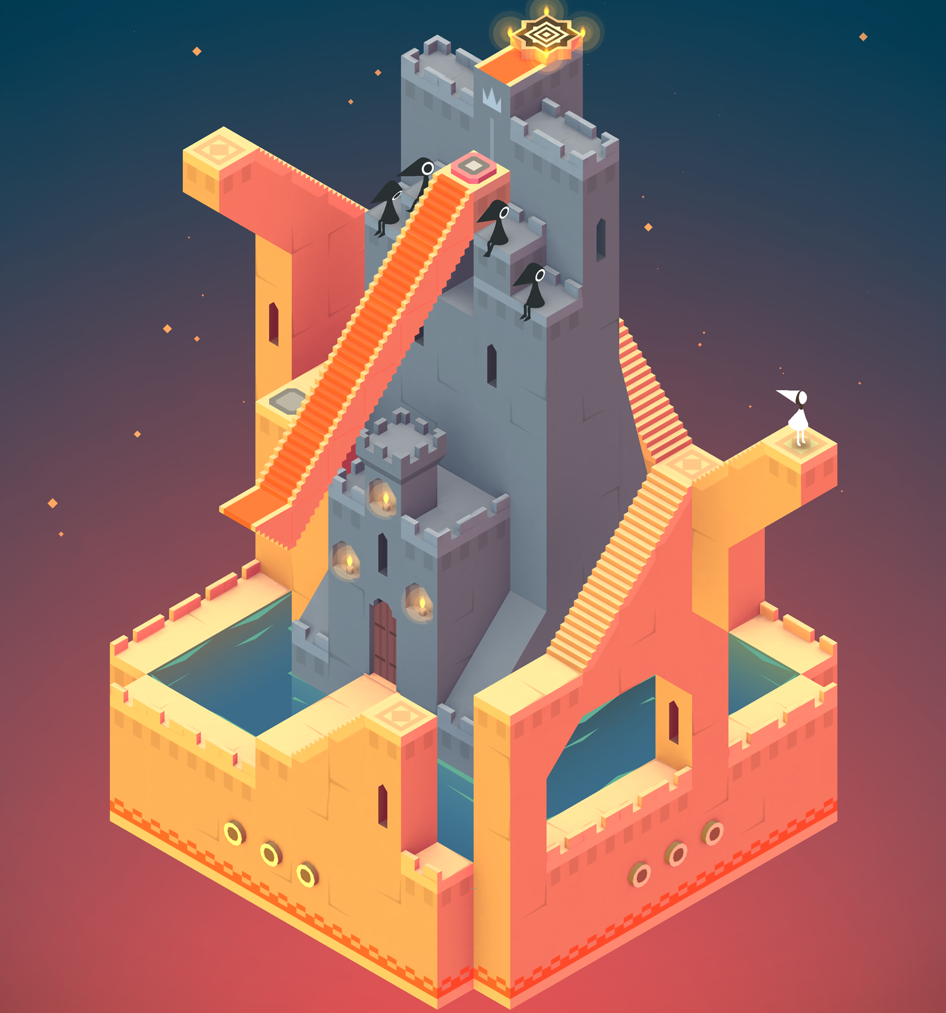
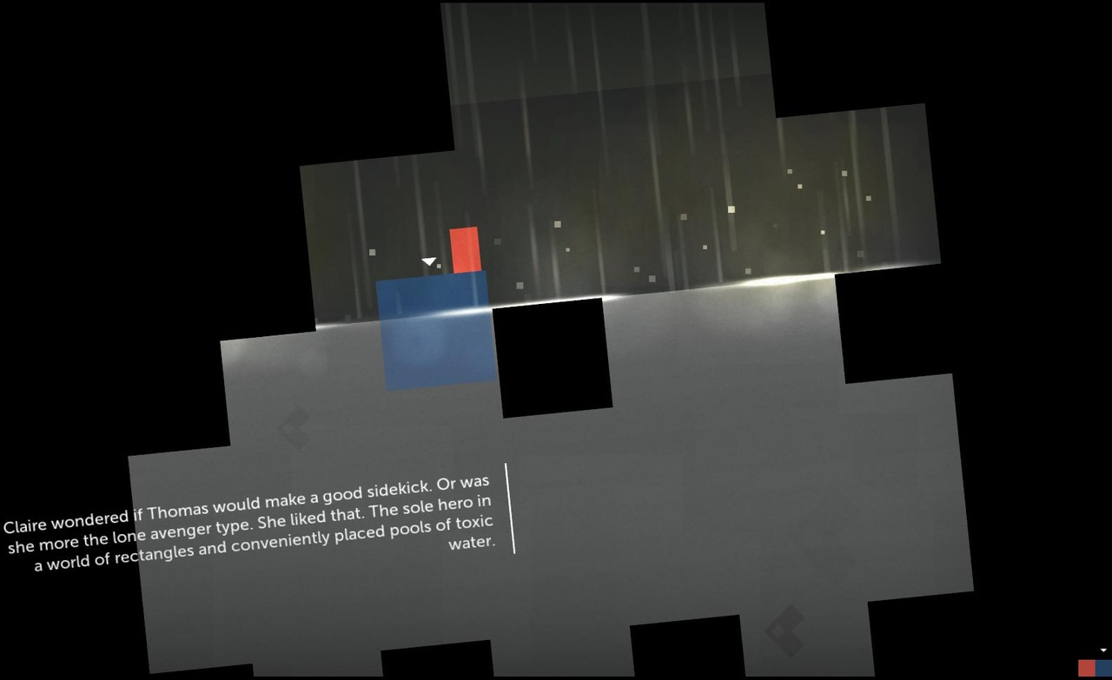
Visual Style
Monument Valley
Game Mechanics
Lara Croft Go
Narrative
Thomas Was Alone

Slide 4
What is Playtesting?
Playtesting is something that the team performs throughout the entire design process to gain an insight into whether or not the game is achieving your player experience goals.

Slide 5
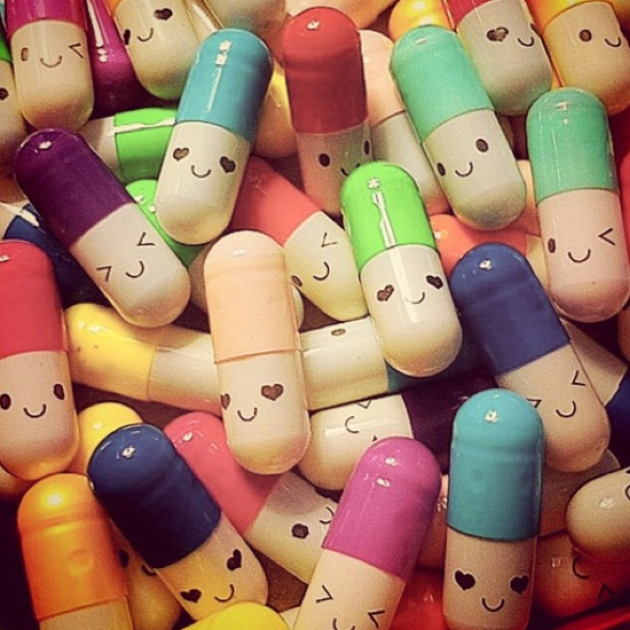
PLAYTESTING PILLS
TAKE ONE EVERY ONE TO TWO WEEKS FOR MAXIMUM EFFECT!
££££££££££££££££££££££££££££££££££
CLINICALLY PROVEN TO HELP YOU GAIN POUNDS FAST!
££££££££££££££££££££££££££££££££££
CLICK HERE TO FIND OUT HOW KING GAINED £1 MILLION POUNDS IN JUST ONE DAY! >

Slide 6
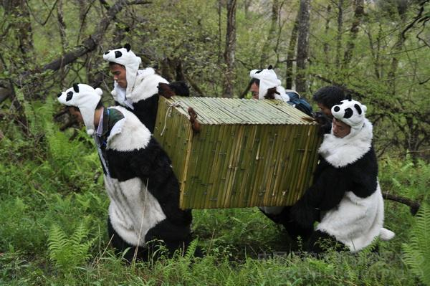

When to Playtest?
Early and Often - it doesn’t need to be bug free
Concept
Prototyping
Production
Alpha
Beta
Release

Slide 7

STEP 1 : Goals
Decide on your goals
Feature Testing - new character, weapons
Controls, Difficulty, Balance, UI
Replayability
Discuss with your team expected outcomes to judge player reactions and results objectively Be specific - easier to test iteratively and to understand as a team
e.g. play time > 20 mins

Slide 8
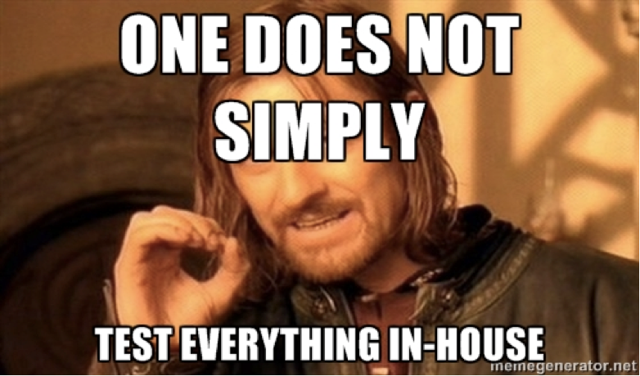
STEP 2 : Organise Tests
Recruit testers
Forums
Events, Gameplay nights
External testers
Peer reviews (eeek!)
Don’t rush into targeting your demographic to early
Create a build that allows you to test your goals clearly
Try to eliminate Bias, recruit fresh meat. Your Dev Team doesn’t count

Slide 9

STEP 3 : Warm Up Discussion
Develop several questions to understand your testers individually
Technical Experience
Familiarity - Platform, genre etc
Favorite Games
Games similar to your own they play and why?
Purchasing habits - paid, freemium, both ........ or our favorite neither.

Slide 10
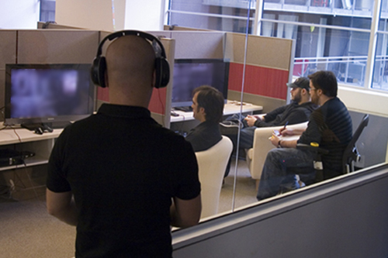
STEP 4 : Conduct Sessions
Be prepared and organised!
5-10 testers should give you a great level of insight
15-20 minute sessions
Methods - Observation, Speak Aloud, Playback Walkthroughs
Don’t jump in, it’s tempting but...

Slide 11
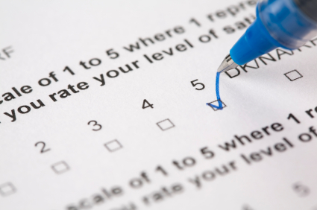
STEP 5 : Tester Survey
Capture what’s in your testers heads.
Quantitative - likert scale - helps normalise consensus e.g. 1-5 star rating
Qualitative - observed not measured e.g. the game looks amazing.
Don’t lead the witness

Slide 12

STEP 6 : Record Observations
Capture what’s in your head.
Note down observations before you forget
Ask any additional session specific questions

Slide 13
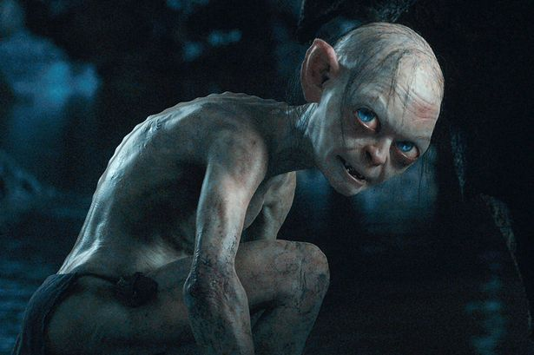
STEP 7 : Review
As a team review the goals and results
Discuss Impact
Define Actions
Don’t be too precious!

Slide 14
Why Playtest?
700+ games are released per day on mobile and desktop. “Magic”?
Successful Game Studios are testing early and often.
You may only get one chance once it’s released.
Core Benefits
Increase your chance of success in an overcrowded market
Save weeks or maximises development time
Improve your team's accountability to focus them on the end user
It’s a roller coaster of emotions!

Slide 15

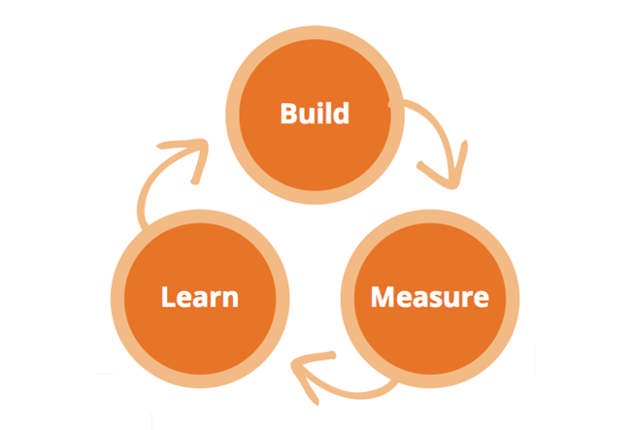
Become Lean!

Slide 16
“Feedback from playtests is useless when it comes too late in the project to make changes”
Peter Molyneux
Video Game Designer and founder of 22 Cans

Slide 17
Questions
Adrian Campbell
Founder, Testify
gotestify.com
@PlayTestify

